Slide 1
Robot Programming with Java
Kevin Wang – 694

Slide 2
Getting Started
Install the Java Development Kit (JDK)
Install NetBeans IDE
Install FRC plugins
Set team number in NetBeans

Slide 3
WPILibJ
“The WPILib Project contains resources for programming an FRC robot in C++ or Java.”
Provides classes for all the basic elements of a robot (joysticks, motor controllers, servos, relays, digital I/O, pneumatics, etc.)
Javadocs, your best friend

Slide 4
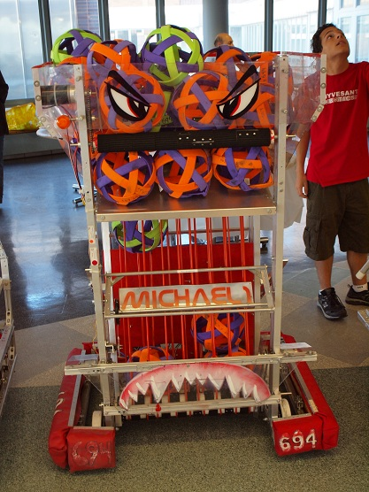
Michael1

Slide 5
SimpleRobot
One of the robot base classes
Your robot's main class extends this class (if you choose to use SimpleRobot)
Key methods
  void autonomous()
    All autonomous code goes here
  void operatorControl()
    All teleop code goes here

Slide 6
Joystick
Constructors
  Joystick(int port)
Key methods
  double getX()
    Returns value between -1.0 and 1.0
  double getY()
  double getRawAxis(int axis)
  boolean getRawButton(int button)
    Returns true if button is being pressed

Slide 7
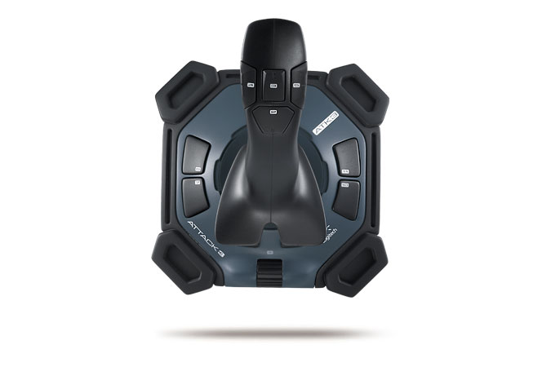
Tank Drive
Left stick
Left side of robot
Right stick
Right side of robot

Slide 8
Arcade Drive
X-axis: turn left/right
Y-axis: Forward/back

Slide 9
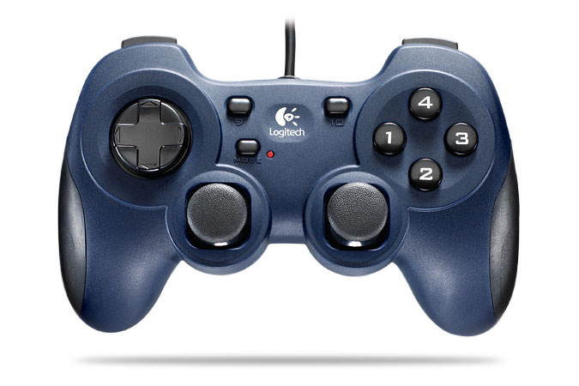
Gamepad Axes
6
5
1
3
2
4

Slide 10
RobotDrive
The drivetrain of the robot
Constructors
  RobotDrive(int leftMotorChannel, int rightMotorChannel)
  RobotDrive(int frontLeftMotor, int rearLeftMotor, int frontRightMotor, int rearRightMotor)
Key methods
  void setInvertedMotor(RobotDrive.MotorType motor, boolean isInverted)
  void tankDrive(GenericHID leftStick, GenericHID rightStick)
  void tankDrive(GenericHID leftStick, int leftAxis, GenericHID rightStick, int rightAxis)
  void arcadeDrive(GenericHID stick)

Slide 11
Victor/Jaguar (PWM)
Constructors
  Victor/Jaguar(int channel)
Key methods
  void set(double speed)
    Input value should be between -1.0 and 1.0
  double get()
    Gets last set value of Victor/Jaguar

Slide 12
Servo
Constructors
  Servo(int channel)
Key methods
  void set(double value)
    Input value should be between 0.0 and 1.0
  double get()

Slide 13
OOPing it up
(OOP = Object-oriented programming)
A robot can be logically abstracted into subsystems
Let's encapsulate each subsystem into its own class

Slide 14
Autonomous Routines
Let's make Michael1:
Drive forward at half speed for 5 seconds while acquiring
Stop driving and acquiring and wait 1 second
Back up at half speed for 2 seconds
Dump balls for 3 seconds

Slide 15
Command-Based Programming
A more complex alternative to SimpleRobot
Subsystems
Commands
  Commands are classes
Let's rewrite Michael1 using CBP!

Slide 16
Check out our code
All of Stuypulse's robot code is open source
2012 code: https://github.com/prog694/joebot
'09-'11 code: https://github.com/prog694/frc
What's GitHub? Find out in my next talk, Version Control with Git (2 pm in Room A)

